Slide 1


Minor Project
Title:Design and Implementation of a CI/CD Pipeline for Automated Deployment
Mentored By:-
Milton Kumar Sir
Activity Co-ordinator:-
Rochak Swami
Presented by:-
500121945- Saksham Gupta
500121881- Rishi Jhunjhunwala
500120365- Akash Meena
500124112- Rishav Gupta

Slide 2
Content
Introduction & Technical Background
Motivation & Problem Statement
Literature Review / Existing Solutions
Project Objectives
Methodology
System Architecture & Design Diagrams
Working Model / Web Application
Results & Testing
Conclusion & Future Scope
References

Slide 3
Introduction & Technical Background
Why CI/CD Matters?
Core Technologies
• CI/CD Pipeline orchestration
• Web Application Architecture
• Database logging and deployment tracking
• GitHub version control
• Containerization using Docker
Modern software development requires fast, reliable, and frequent updates.
Traditional manual deployment processes are time-consuming and prone to human errors, which often leads to delays and system instability.
Continuous Integration and Continuous Deployment (CI/CD) pipelines automate the processes of building, testing, and deploying software applications.
By automating these processes, CI/CD improves development efficiency, reduces human error, and ensures faster delivery of software updates.

Slide 4
Motivation & Problem Statement
The Challenge
Software development teams often lack centralized systems to effectively track deployments and monitor release updates.
Manual deployment tracking introduces several problems such as errors, poor visibility, and lack of historical data, making it difficult to manage deployment processes efficiently.
Proposed Solution
To address this challenge, this project proposes the development of a lightweight web-based deployment monitoring system integrated with a CI/CD pipeline.
The system will automate deployment tracking, reduce manual errors, improve deployment visibility, and provide practical DevOps implementation experience.

Slide 5
Area of Application & Dataset
Target Applications
• Software development organizations
• DevOps engineering teams
• Release management operations
• Deployment monitoring systems
Input Data Structure
The system processes deployment-related data generated during CI/CD pipeline execution.
The stored data includes:
• Deployment ID and application version
• Build status and test results
• Deployment timestamps
• Release notes and update information
• System logs generated during pipeline execution
This structured dataset allows the dashboard to provide real-time monitoring and historical deployment analysis.

Slide 6
Existing Solutions
Jenkins CI/CD
Enterprise-grade automation server used for building and deploying applications.
GitHub Actions
Integrated workflow automation platform used directly with GitHub repositories.
GitLab CI/CD
A complete DevOps platform that provides CI/CD capabilities integrated with source control.
CircleCI
Cloud-based CI/CD platform designed for automated testing and deployment.

Slide 7
SWOT Analysis
Strength
Automated deployment tracking with real-time monitoring.
Weakness
Limited scalability compared to enterprise-grade DevOps platforms.
Opportunity
Integration with cloud services and expansion into full DevOps monitoring platforms.
Threat
Competition from well-established DevOps tools already used in industry.

Slide 8
Project Objectives
1 — Develop Web Dashboard
Create an intuitive user interface to monitor deployments and track system updates.
2 — Store Deployment Data
Design and implement a database system to store deployment records and release information.
3 — Implement CI/CD Pipeline
Automate build, testing, and deployment workflows using CI/CD tools.
4 — Automate Updates
Enable automatic deployment status updates through pipeline integration.
5 — Track Deployment History
Maintain a complete record of deployments for analysis and monitoring.

Slide 9
Methodology
Development Model: Incremental Development
1. Requirement Analysis
Identify system requirements, define deployment tracking needs, and analyze system scope.
2. System Design
Design system architecture, database schema, and application workflow.
3. Web Application Development
Develop frontend dashboard and backend application for deployment tracking.
4. CI/CD Integration
Connect automated CI/CD pipeline with the web application.
5. Testing
Test functionality, deployment workflows, and database operations.
6. Deployment
Deploy the system and monitor application performance.
Tools Used:
• GitHub (Version Control)
• GitHub Actions / CI/CD Tool
• Docker (Containerization)
• Web Application Framework (Frontend + Backend)
• Database (MySQL / MongoDB)

Slide 10
Working Model & Architecture
System Architecture
Developer
Developers commit code changes to the version control repository.
GitHub Repository
Source code is stored and managed using GitHub.
CI/CD Pipeline
The pipeline automatically builds and tests the application.
Web Application
A dashboard interface displays deployment information and
monitoring data.
Database
Stores deployment records, logs, and release history.
Key Modules
Dashboard Module
Displays deployment statistics and real-time monitoring information.
Tracking Module
Tracks deployment processes and build status.
Release Module
Manages application version updates and release notes.
Database Module
Stores deployment logs and application data.
CI/CD Module
Automates build and deployment workflows.

Slide 11
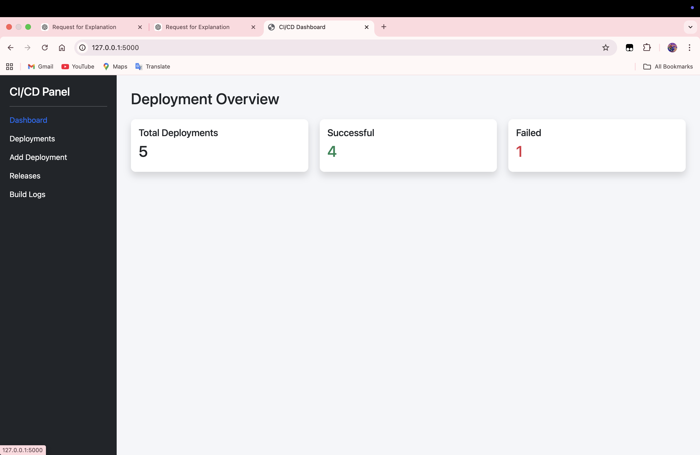
Working Model / Web Application Screens
Dashboard Page: Dashboard showing total deployments, successful deployments, and failed deployments.

Slide 12
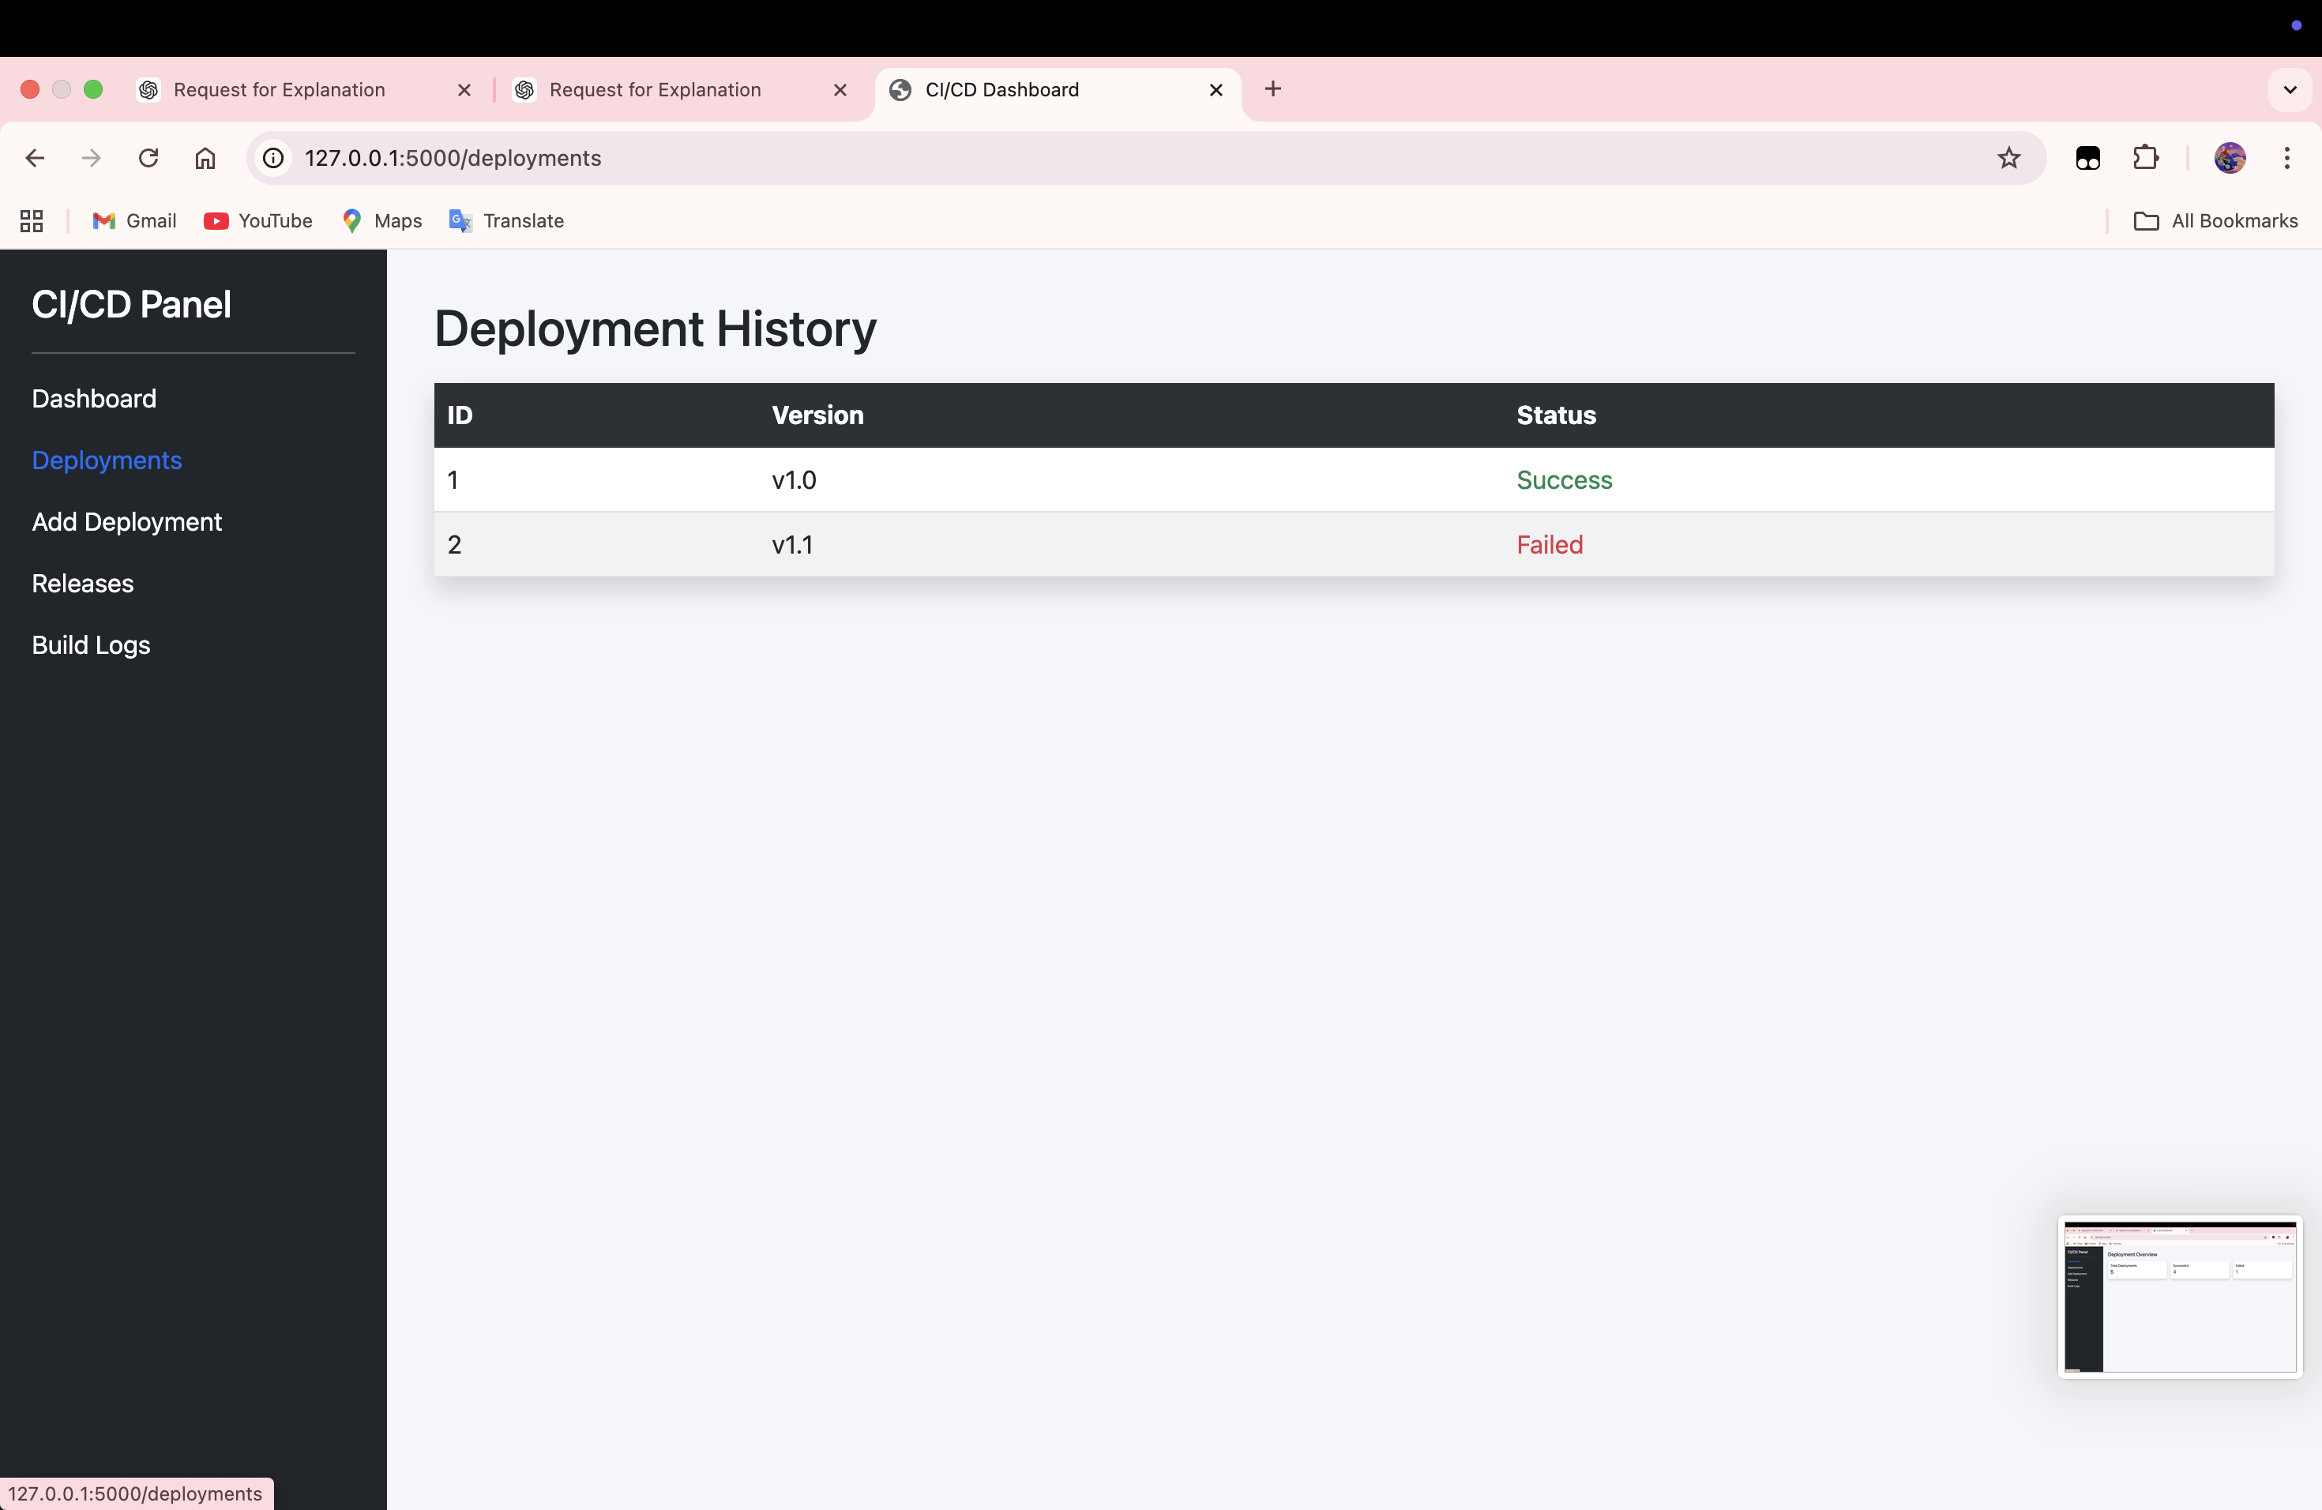
Deployment History Page: shows version-wise deployment status.

Slide 13
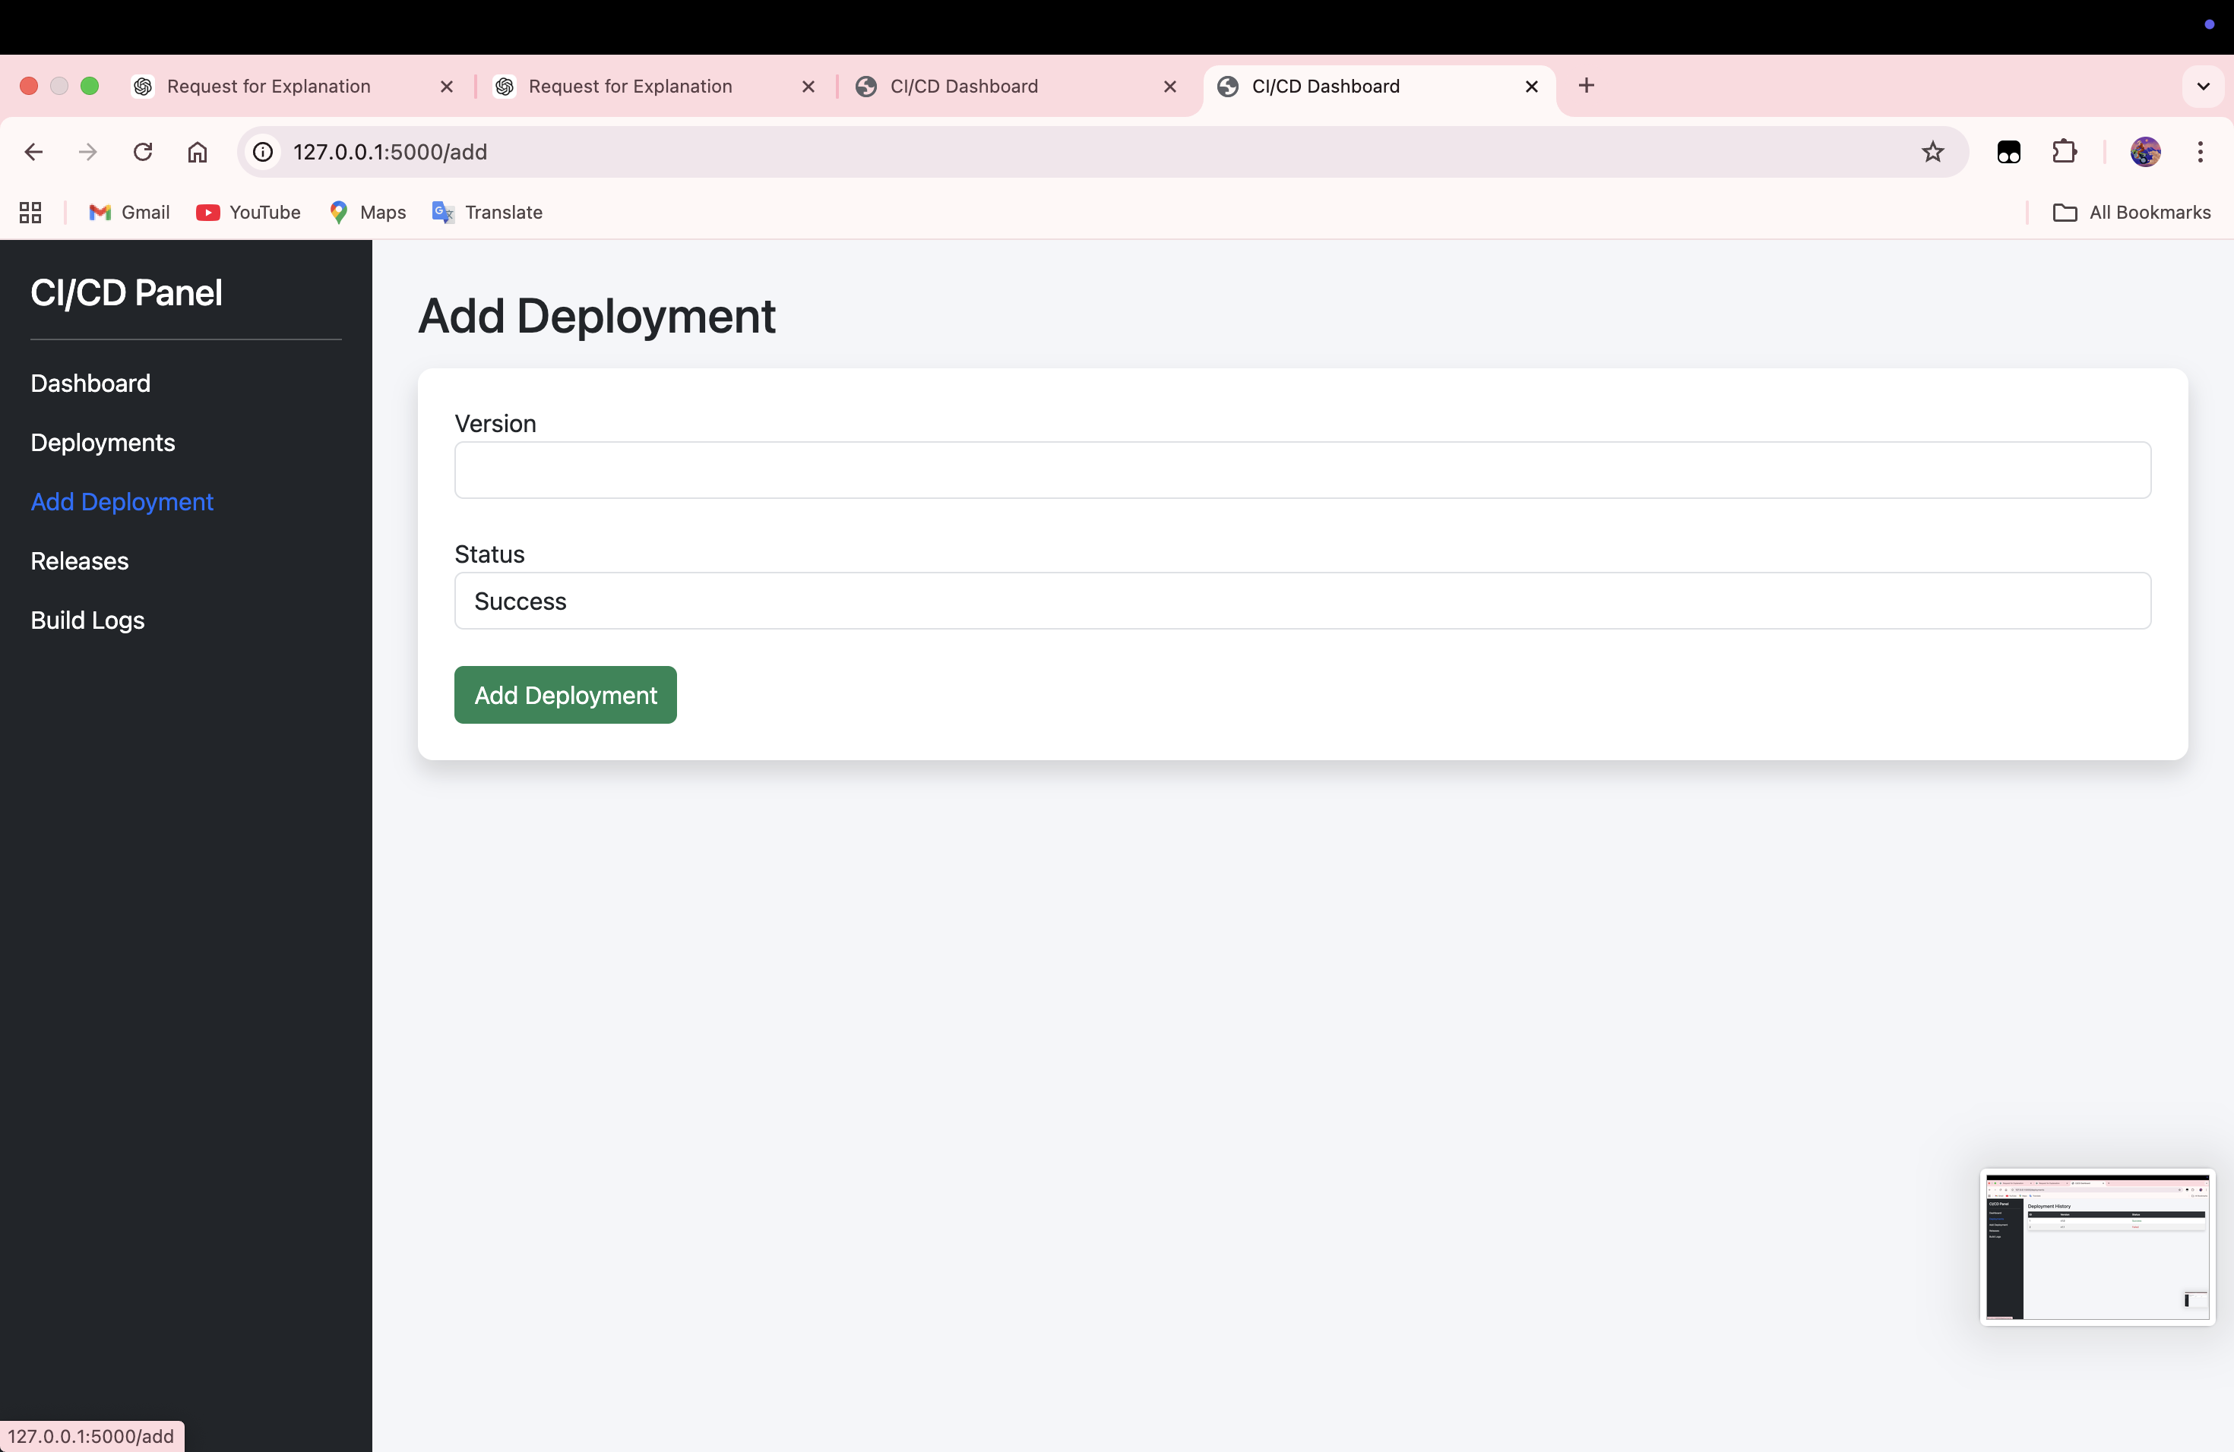
Add Deployment Page: used to insert deployment records into the system.

Slide 14
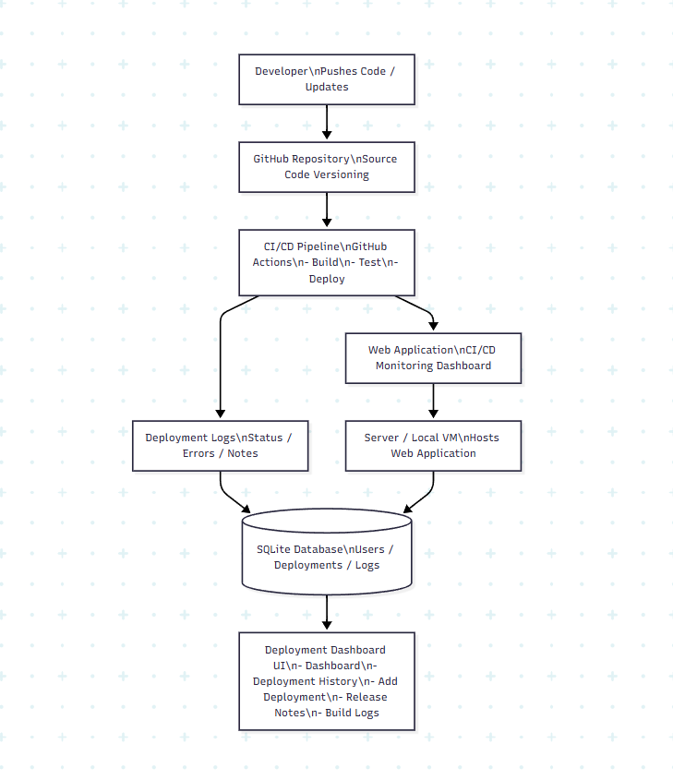
System Architecture
Developer commits code to GitHub repository.
CI/CD pipeline automatically triggers build and testing process.
If tests pass, application deployment is executed.
Deployment results and logs are stored in the database.
DevOps Deployment Dashboard retrieves and displays deployment data.

Slide 15
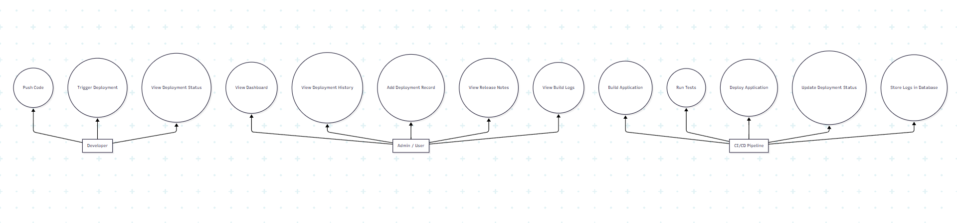
Use Case Diagram
Represents interactions between users and the system.
Shows system functionalities available to developers and administrators.
CI/CD system updates deployment results automatically.
Main actions include viewing dashboard, monitoring deployments, and managing logs.

Slide 16
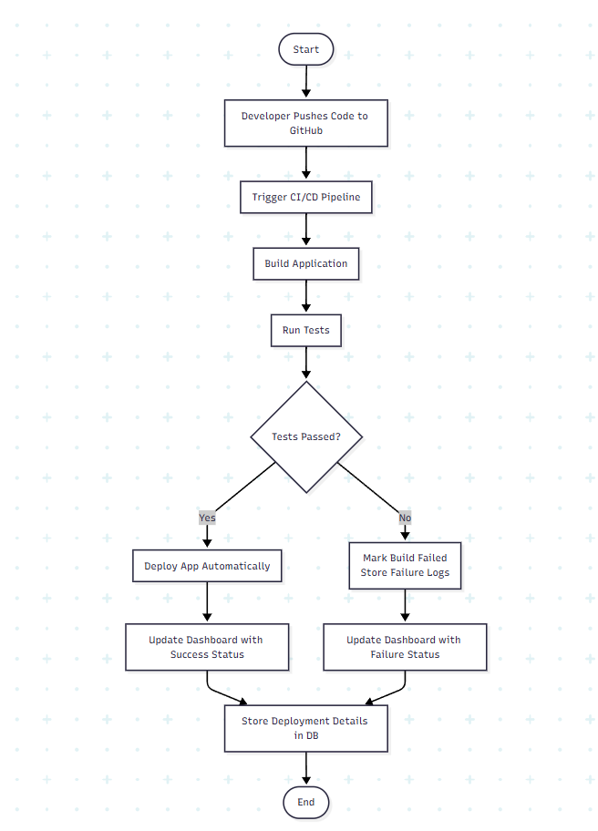
Activity Diagram
llustrates the workflow of automated deployment.
Starts when developer pushes code to GitHub.
CI/CD pipeline performs build and testing.
If tests pass, application is deployed.
Dashboard updates deployment status.

Slide 17
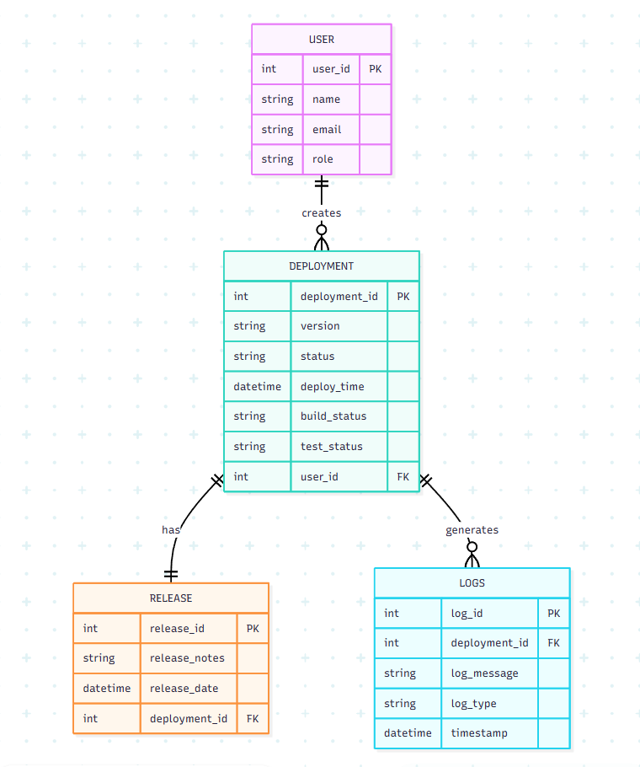
ER Diagram
Shows database structure of the system.
Main entities include User, Deployment, Release, and Logs.
Defines relationships between deployment records and logs.
Helps manage deployment history and system monitoring.

Slide 18
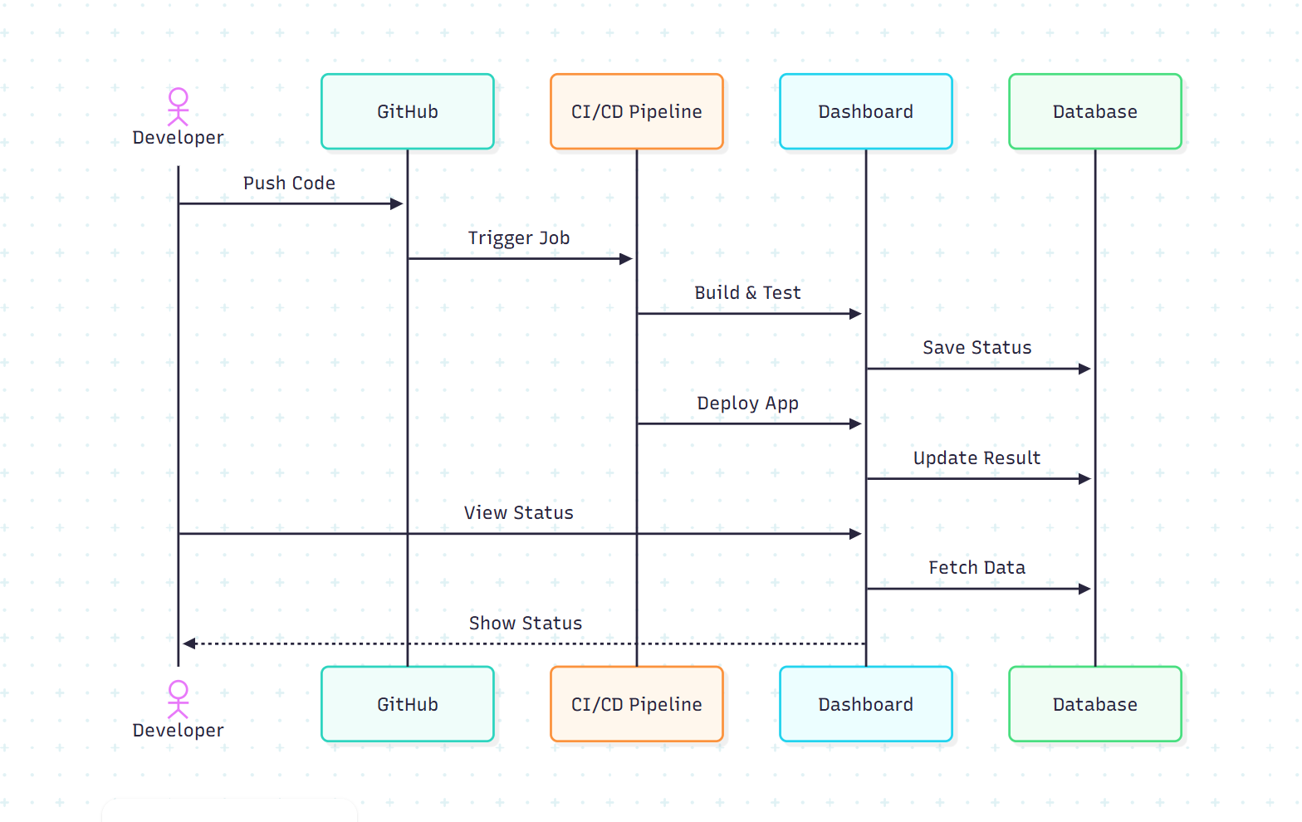
Sequence Diagram
Describes interaction between system components over time.
Developer pushes code to GitHub.
CI/CD pipeline processes build and deployment.
Dashboard retrieves deployment data from database.
Users can view deployment status.

Slide 19
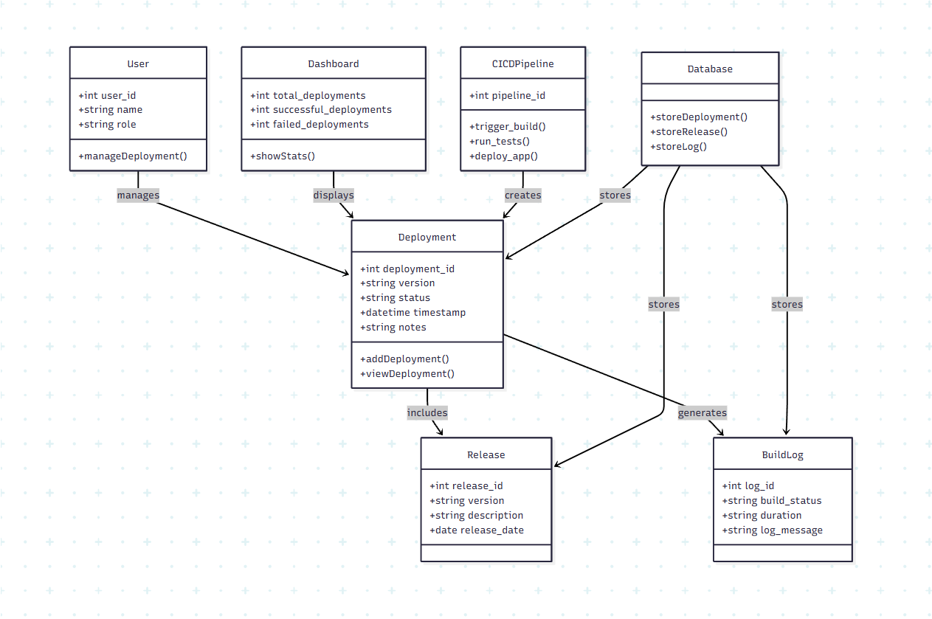
Class Diagram
Represents object-oriented structure of the system.
Includes classes such as User, Deployment, Release, Logs, and CICDPipeline.
Shows attributes, methods, and relationships between system components.

Slide 20
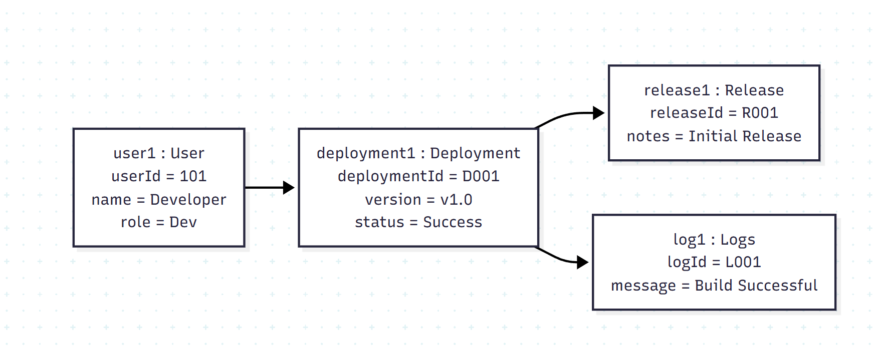
Object Diagram
Represents real-time instances of system classes.
Shows how objects like User, Deployment, Release, and Logs interact.
Helps visualize system state during a deployment process.

Slide 21
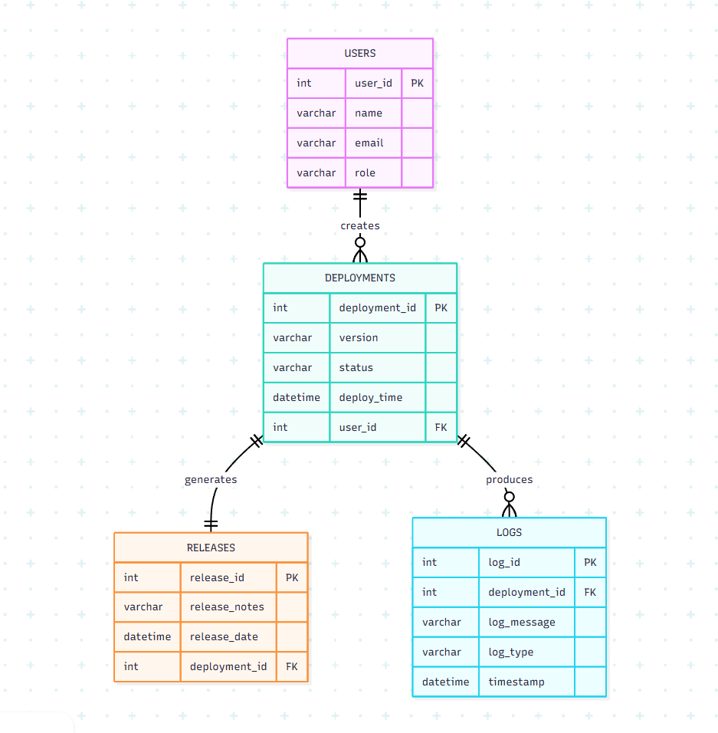
Database Schema Diagram
Shows the structure of the database used in the system.
Tables include Users, Deployments, Releases, and Logs.
Relationships store deployment history, logs, and release details.

Slide 22
Results & Testing
Test Case Outcomes
Deployment Entry
Deployment data successfully recorded with accurate timestamps and status tracking.
Dashboard Update
Dashboard correctly displays real-time build status and deployment history.
CI/CD Execution
Automated pipeline successfully builds and deploys application updates.
Key Achievements
• Automated deployment tracking implemented successfully.
• Improved deployment visibility through real-time monitoring.
• Reduced manual monitoring effort using automated workflows.
Performance Observation
• Deployment tracking improved system visibility.
• Automated pipeline reduced manual deployment errors.
• Dashboard enabled quick identification of failed builds.
• Deployment records were successfully stored and retrieved from the database.

Slide 23
Conclusion & Future Scope
Future Enhancements
Cloud Deployment
Extend system to cloud platforms such as AWS, Azure, or GCP.
Kubernetes Integration
Use container orchestration for scalable deployments.
Real-Time Alerts
Implement notification system for deployment events.
DevSecOps Integration
Integrate security scanning into the CI/CD pipeline.
Advanced Dashboards
Add analytics and performance monitoring capabilities.
Project Success
• CI/CD pipeline successfully implemented for automated deployment.
• Web application dashboard developed for deployment monitoring.
• Real-time deployment tracking demonstrated successfully.

Slide 24
References
Humble, J., & Farley, D. (2010). Continuous Delivery: Reliable Software Releases through Build, Test, and Deployment Automation.
GitHub Documentation – CI/CD Workflows
Jenkins Official Documentation
Docker Documentation – Containerized Deployment
Fowler, M. (2014). Continuous Integration Practices

Slide 25
Thank You

